Slide 1
Sequencing 101

Slide 2
(The incomplete) history of sequencing
Chain termination:
Sanger sequencing

Slide 3
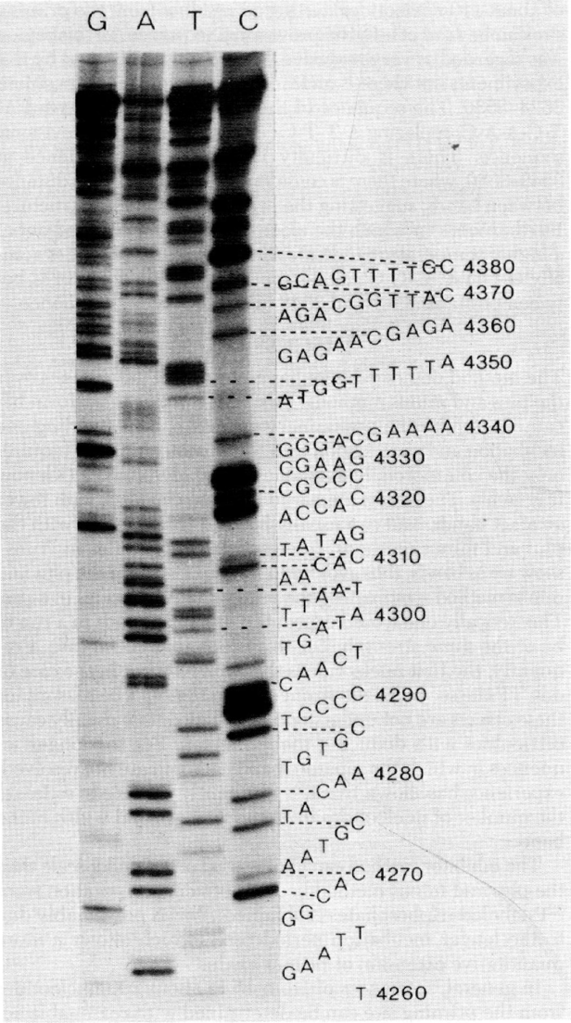
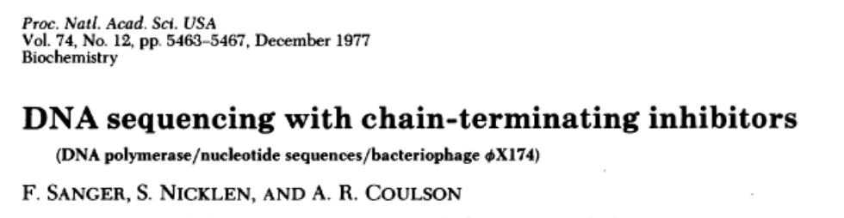
(The incomplete) history of sequencing
Chain termination:
Sanger sequencing

Slide 4
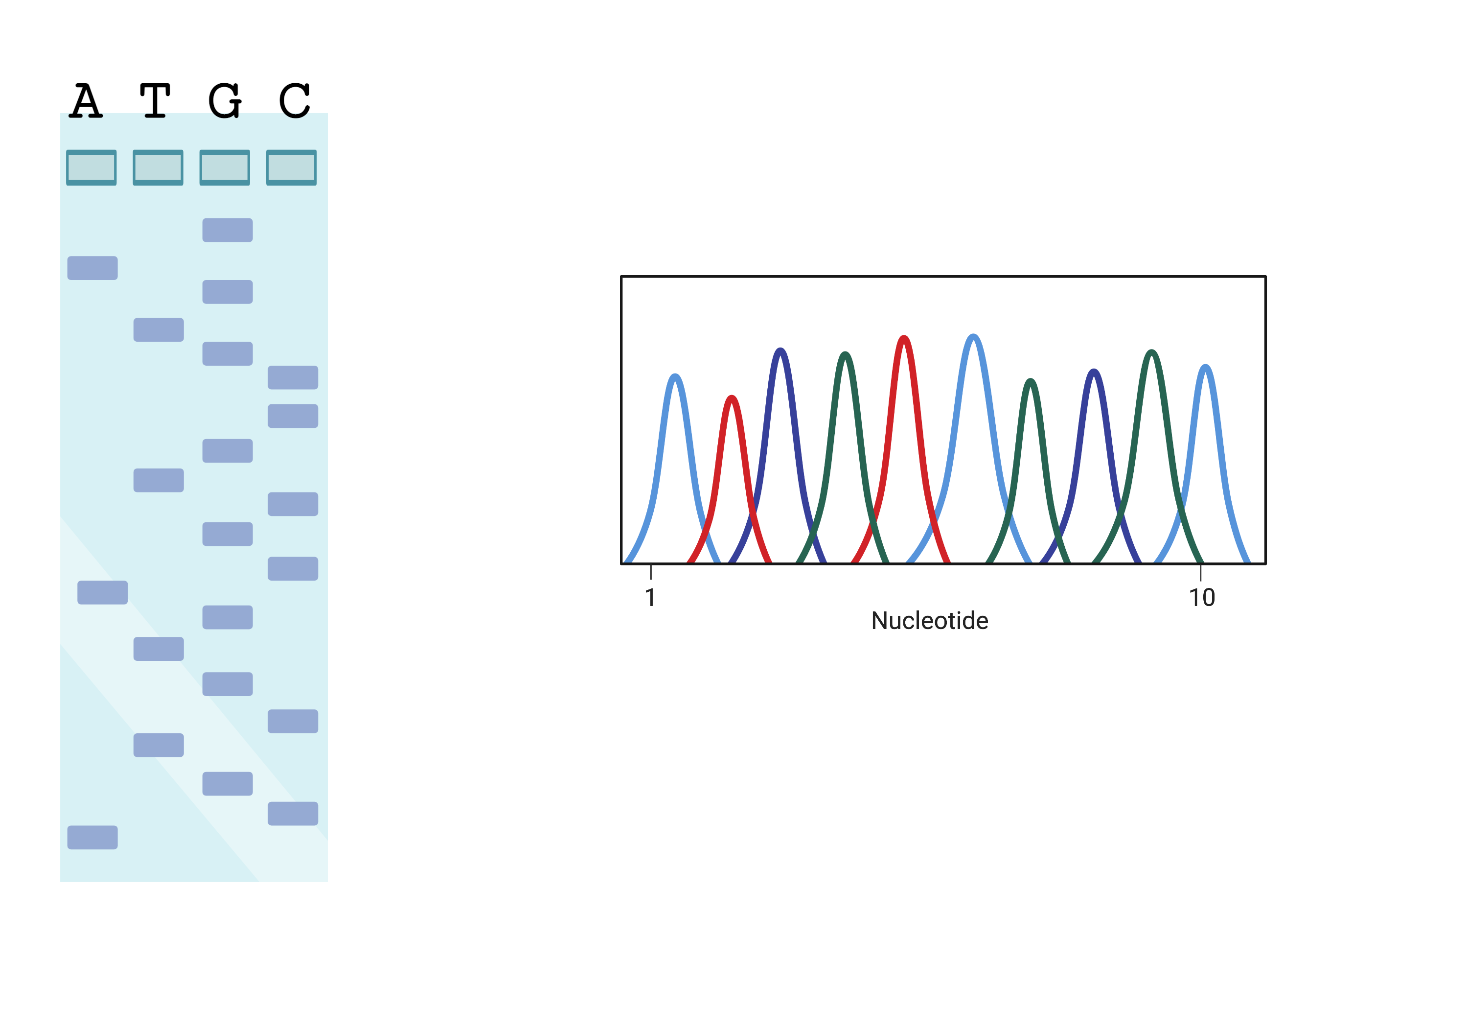
(The incomplete) history of sequencing
Chain termination:
Sanger sequencing

Slide 5
(The incomplete) history of sequencing
High-throughput Sanger sequencing
Dye-terminators and capillary electrophoresis

Slide 6
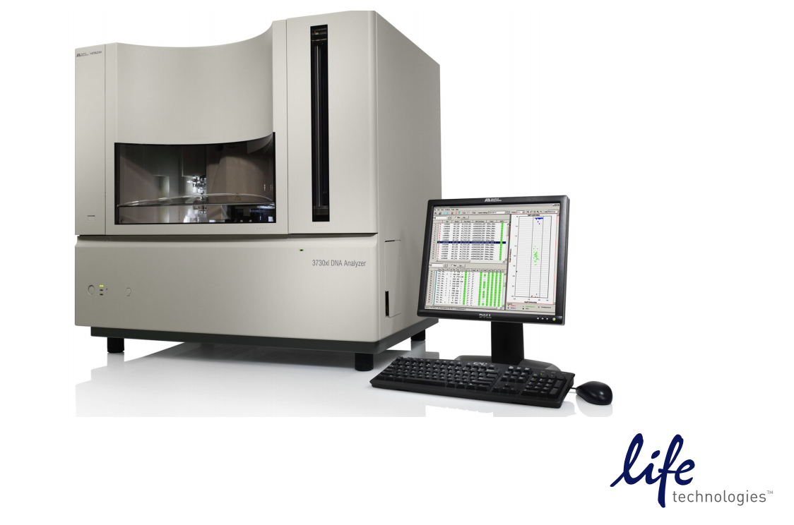
(The incomplete) history of sequencing
High-throughput Sanger sequencing
Dye-terminators and capillary electrophoresis

Slide 7
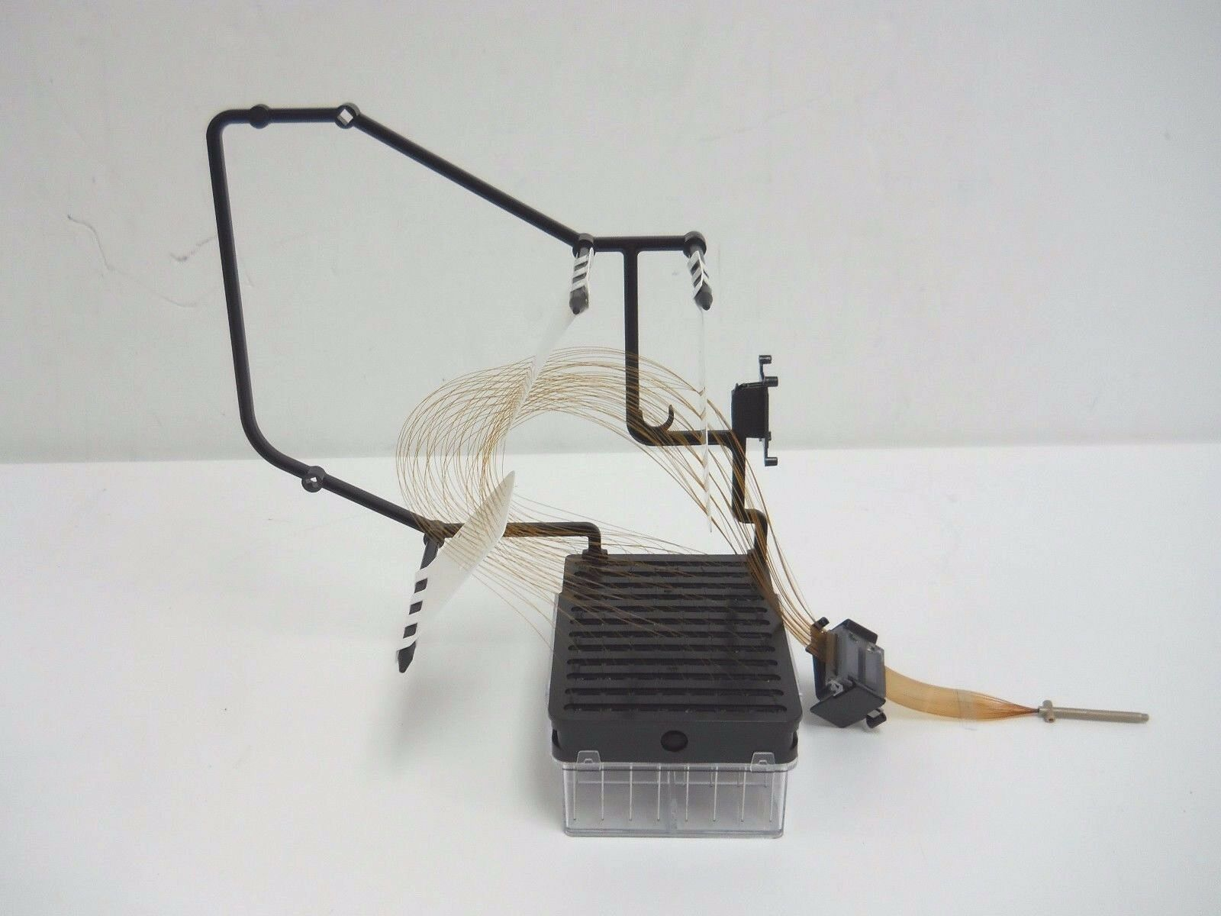
(The incomplete) history of sequencing
High-throughput Sanger sequencing
Dye-terminators and capillary electrophoresis
48/96 –capillars
Read length < 900 bp
< 90 Kbp / run

Slide 8
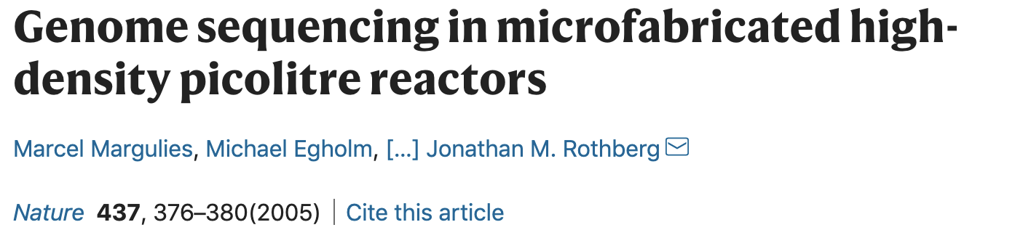
(The incomplete) history of sequencing
Sequencing by synthesis:
Pyrosequencing

Slide 9
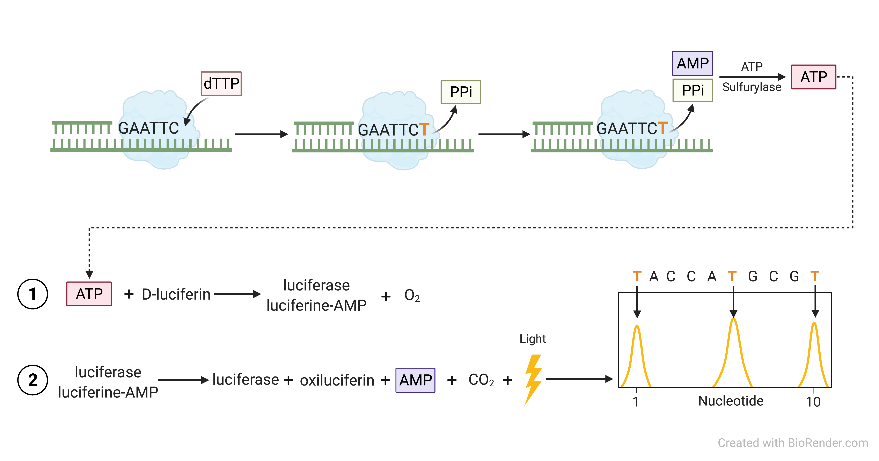
(The incomplete) history of sequencing
Sequencing by synthesis:
Pyrosequencing

Slide 10
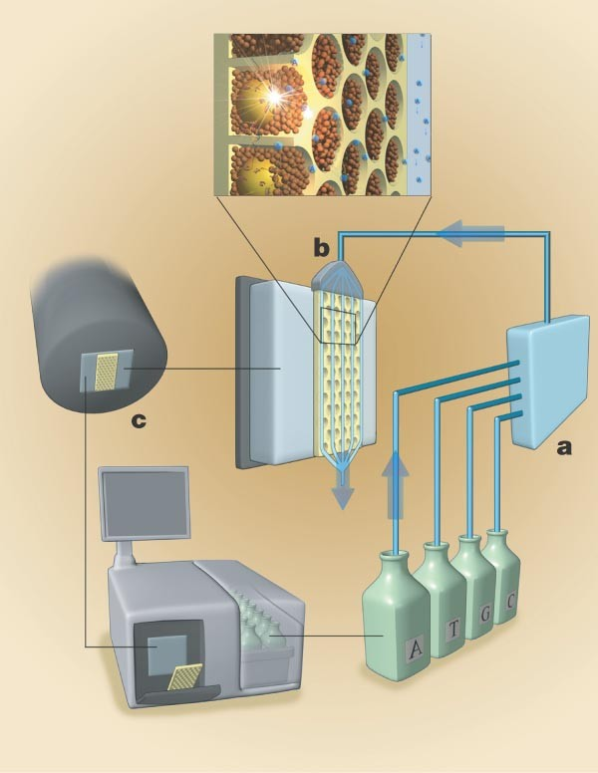
(The incomplete) history of sequencing
Sequencing by synthesis:
Pyrosequencing
Marguelis et al., 2005. Nature
Read length ~ 400–1000 bp
20 – 600 Mbp / run

Slide 11
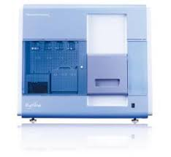
(The incomplete) history of sequencing
Sequencing by synthesis:
Short-read sequencing
Illumina (Solexa)
Genome Analyzer, 2006
1 Gbp / run

Slide 12
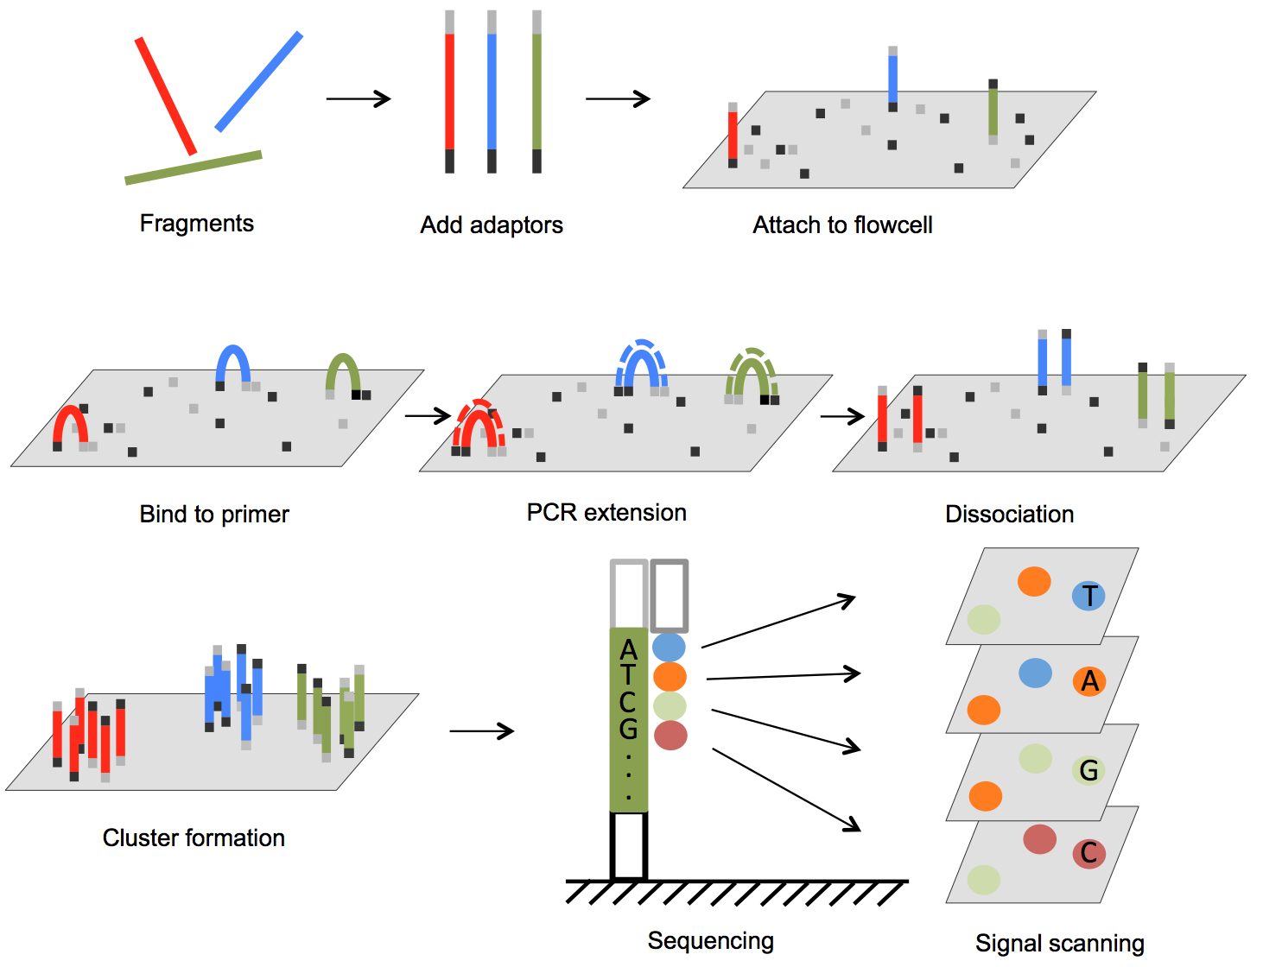
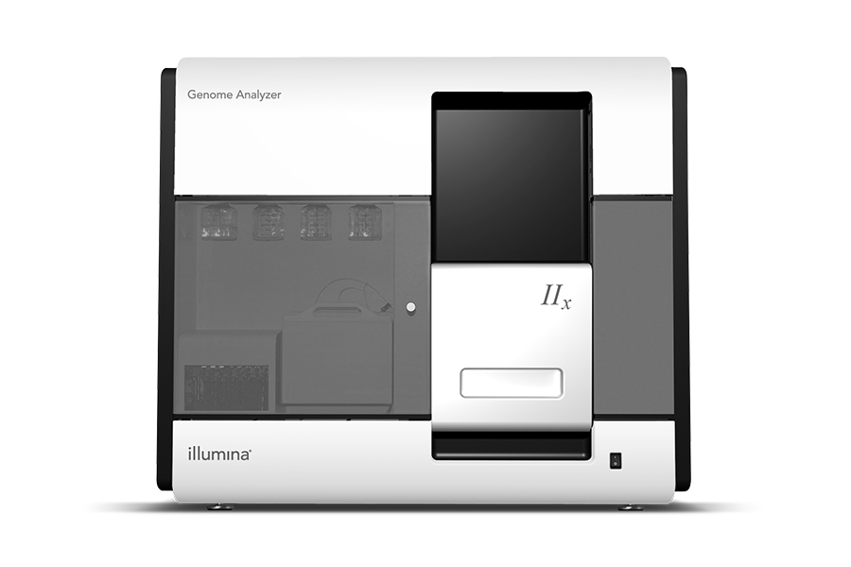
(The incomplete) history of sequencing
Sequencing by synthesis:
Short-read sequencing
Illumina
Genome Analyzer IIx, 2008
20 Gbp / run (9.5 days)

Slide 13
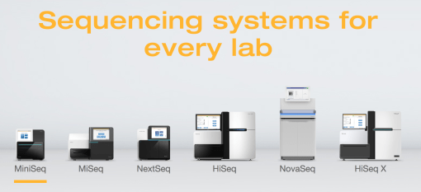
(The incomplete) history of sequencing
Sequencing by synthesis:
Short-read sequencing
1 Gbp – >1 Tbp / run (~1–2 d)

Slide 14
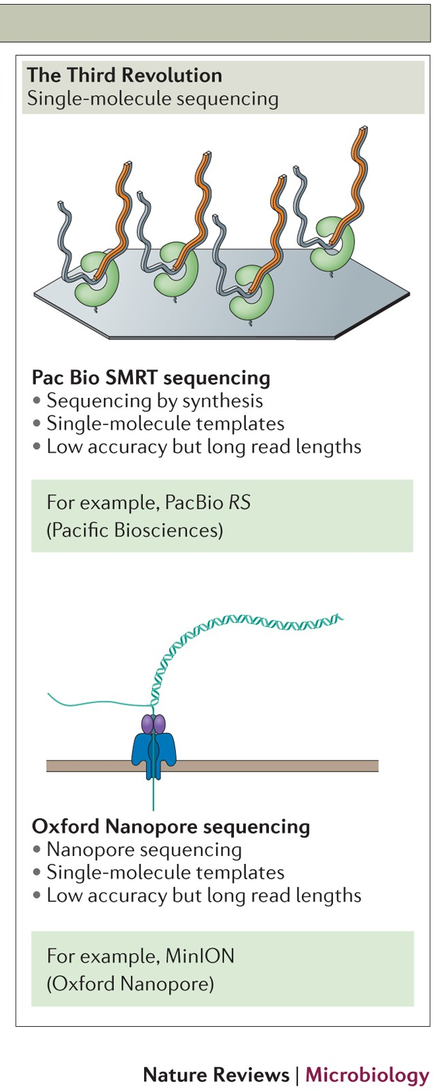
(The incomplete) history of sequencing
Third revolution:
Long-read sequencing

Slide 15
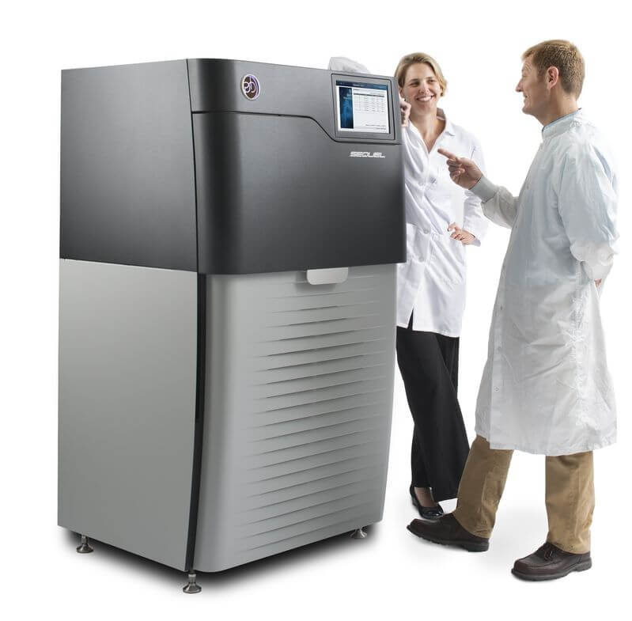
(The incomplete) history of sequencing
Third revolution:
Long-read sequencing

Slide 16
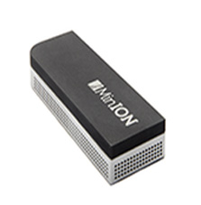
(The incomplete) history of sequencing
Third revolution:
Long-read sequencing

Slide 17
(The incomplete) history of sequencing
Third revolution:
Long-read sequencing
Sequel II
HiFi reads: Read length:
20 kb
30 Gbp /run
(99.92 % acc.)
Minion:
Read length:
> 4 Mb
1–50 Gbp /run
(~ 97 % acc.)
Real-time!

